Slide 1

Database for Clinic Management
Teeratass Peyasantiwong 6480651
Milin Amornruttanadecha 6480303

Slide 2
Purpose:
Patient Record
Appointment
Management for Doctor, Staff, and/or Patient
Billing and Payments
Medical Test
Branch Management
Medication Inventory

Slide 3
Reminder:
Please overlook “Center Div”
Mockup UI is general

Slide 4
Reminder:
Please overlook “Center Div”
Mockup UI is general

Slide 5
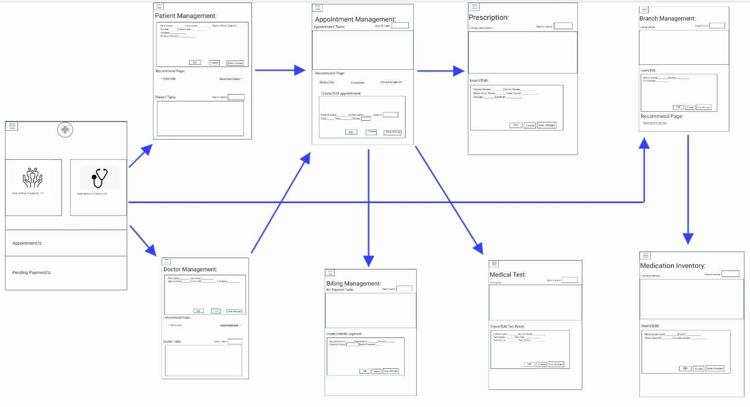
Site Map:

Slide 6
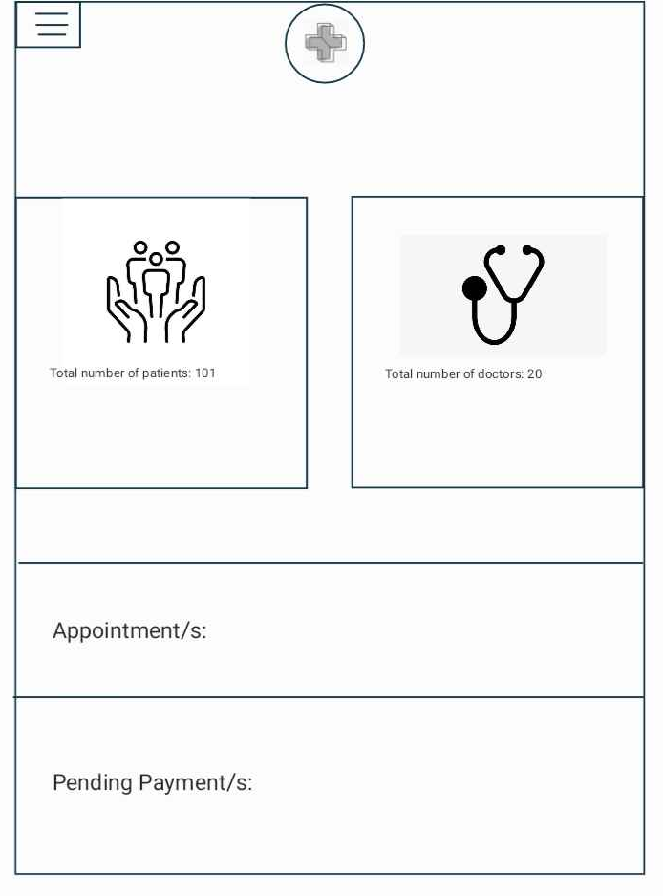
Home page
Number of patients
Number of Doctors
On-going appointment/s
Pending Payment/s

Slide 7
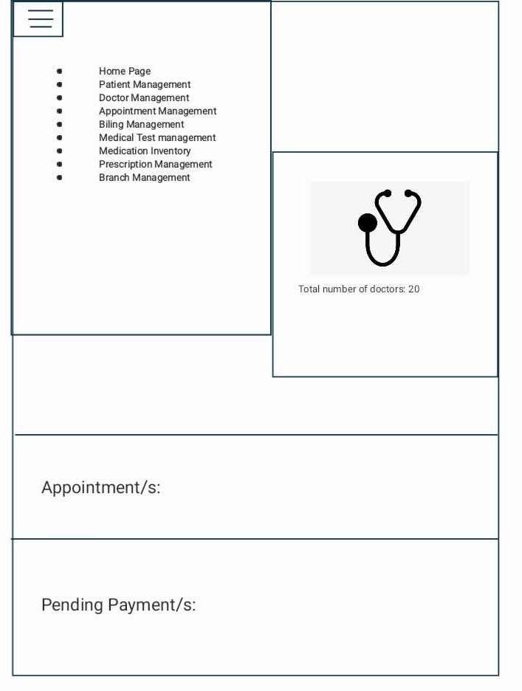
Home page
Number of patients
Number of Doctors
On-going appointment/s
Pending Payment/s

Slide 8
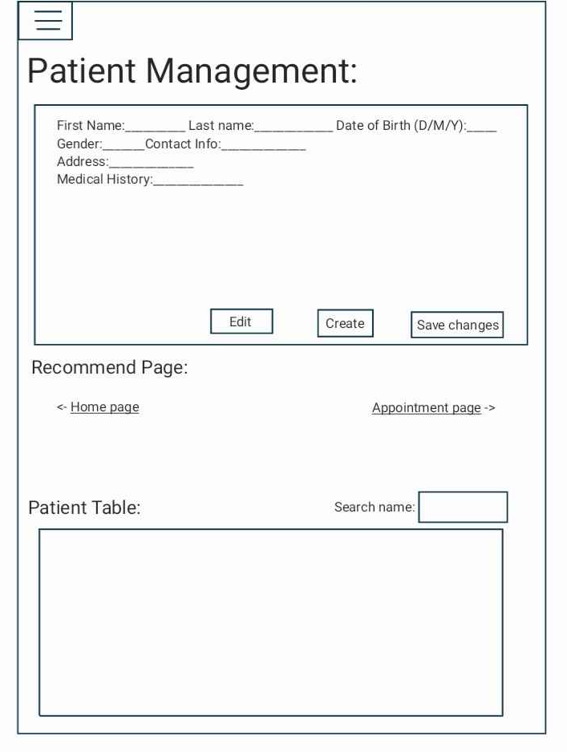
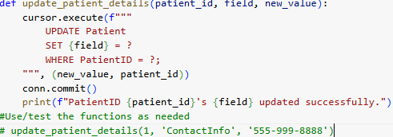
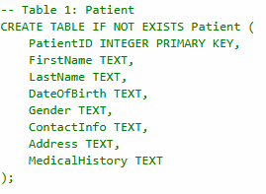


PatientID FirstName LastName DateOfBirth Gender ContactInfo Address MedicalHistory
0 1 John Doe 1980-05-15 Male 555-999-888 Wolf Street 29 Diabetes

Slide 9
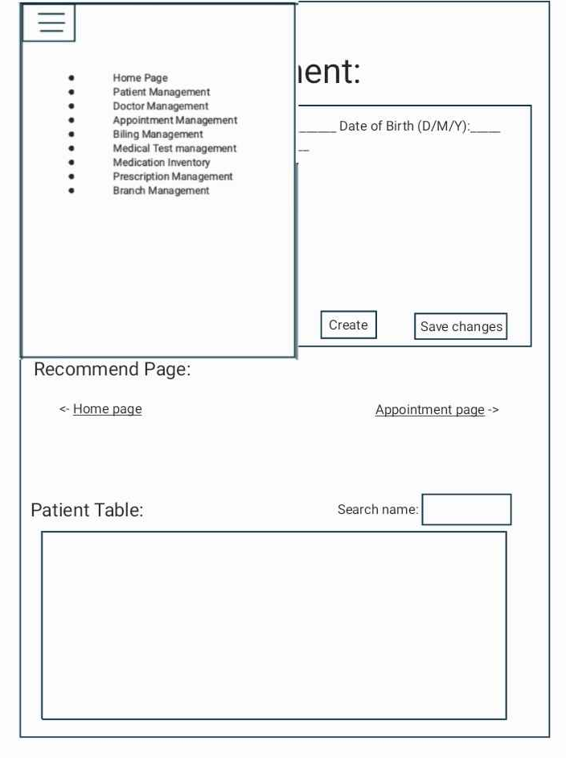

Slide 10
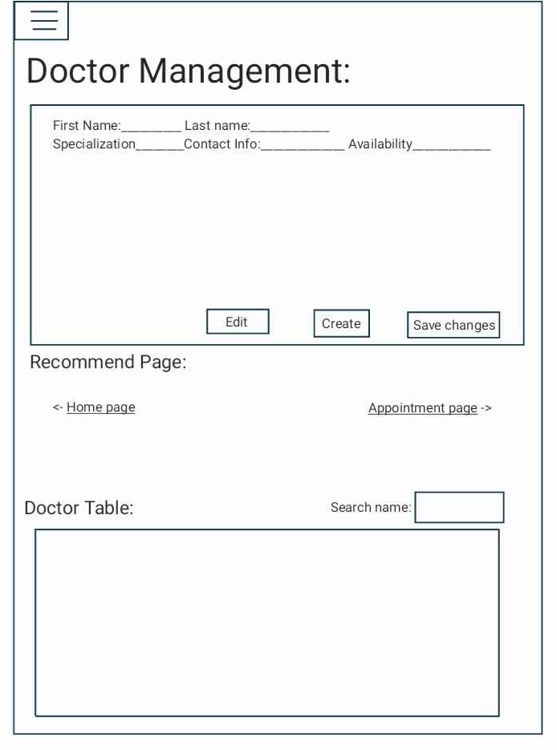
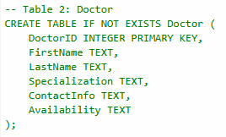





Slide 11
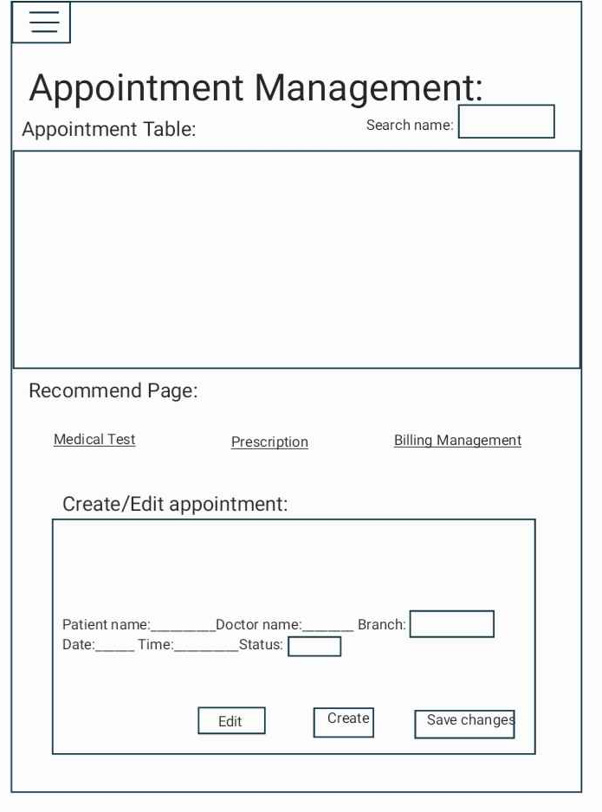


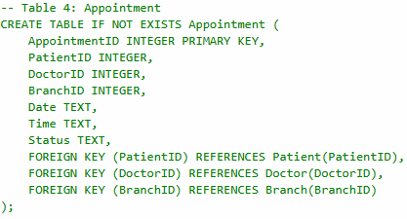




Slide 12
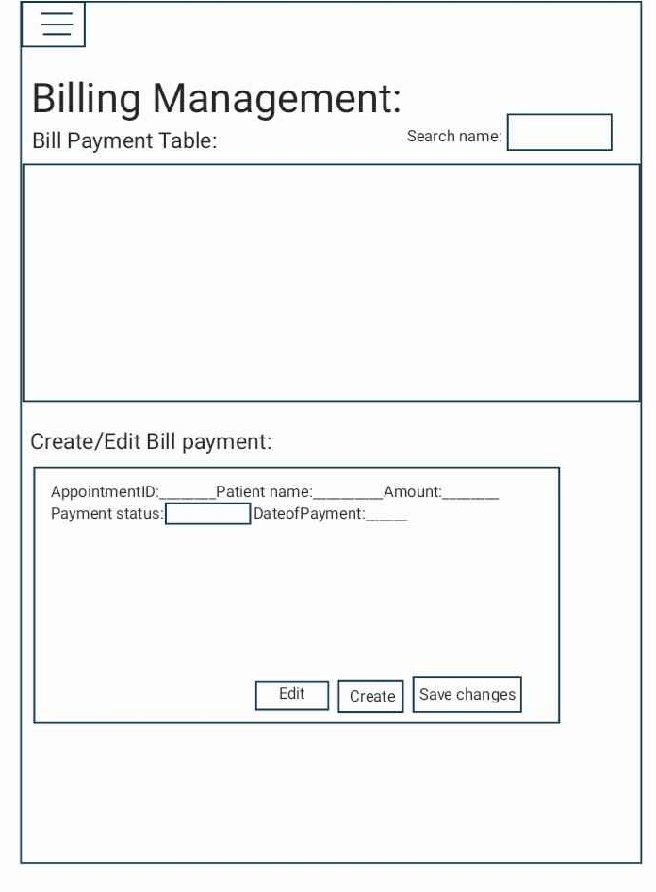


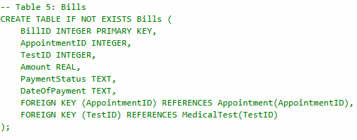


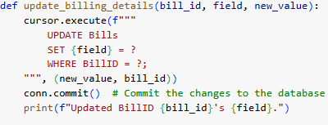

Slide 13
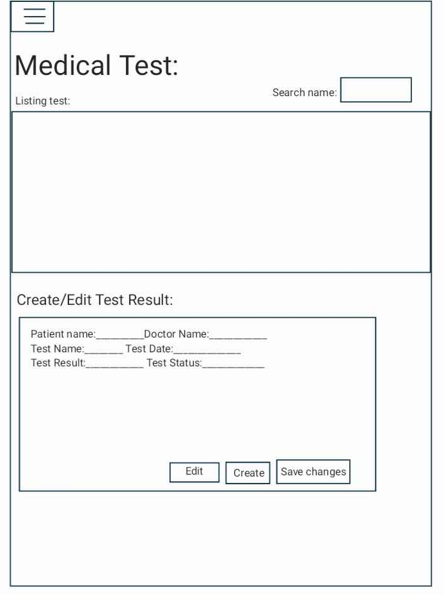


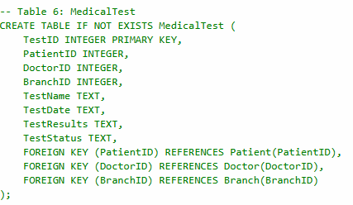


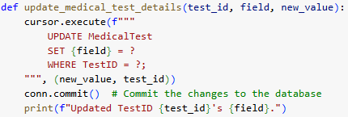

Slide 14
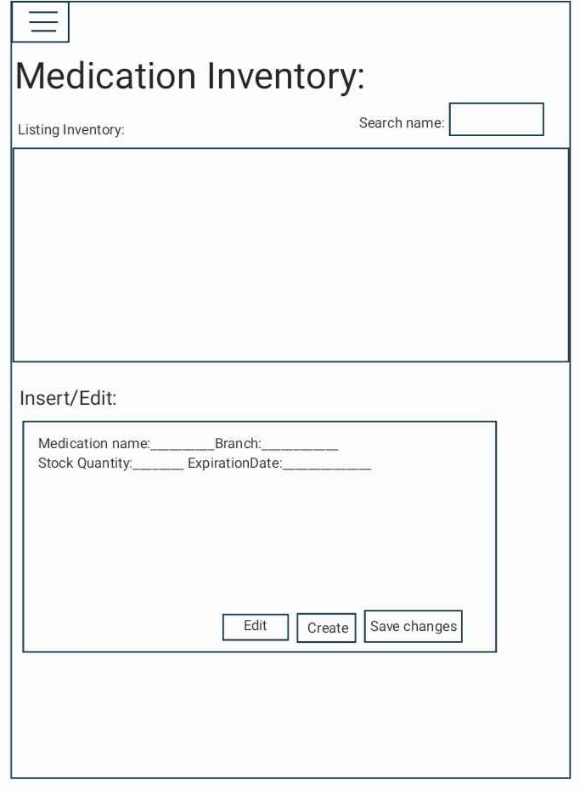


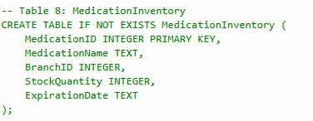




Slide 15
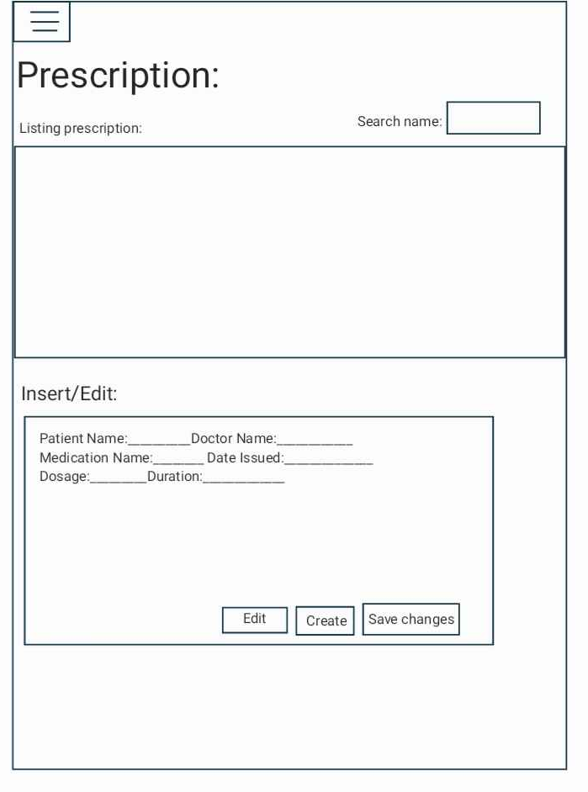


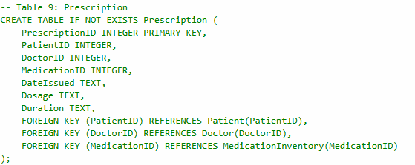




Slide 16
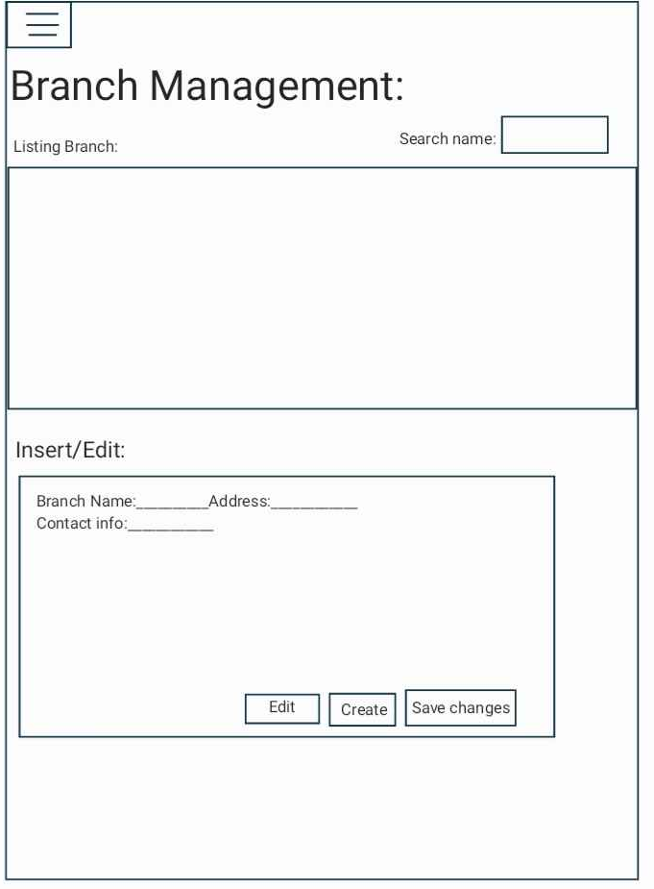


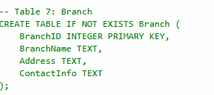




Slide 17
Improvements:
Enhance Searching Tools (e.g. Filtering)
Coordinates/Map for Each Branch
Privacy for Users
Adding Photos and Videos for Medical Test

Slide 18
Thank You

